Slide 1
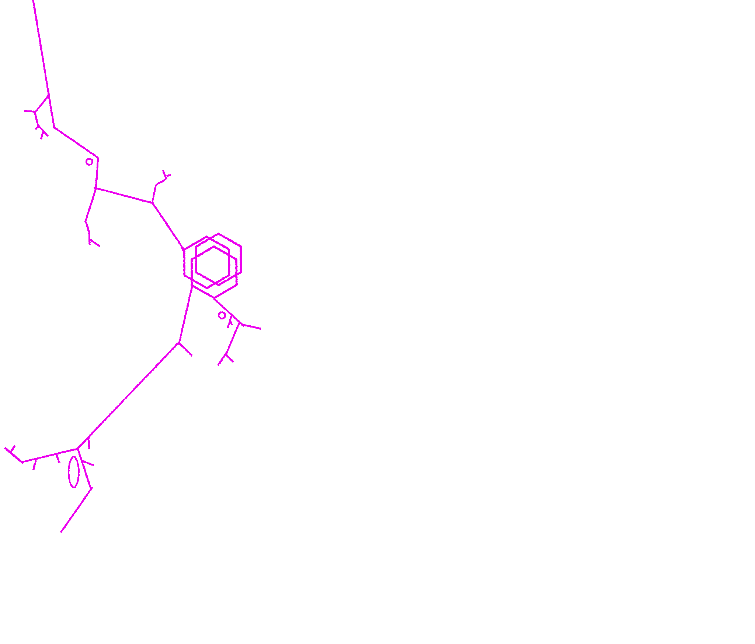

The Starbreaker
A Supply Drop Playbook By Lawson Coleman
For Austin Ramsay’s Beam Saber

Slide 2
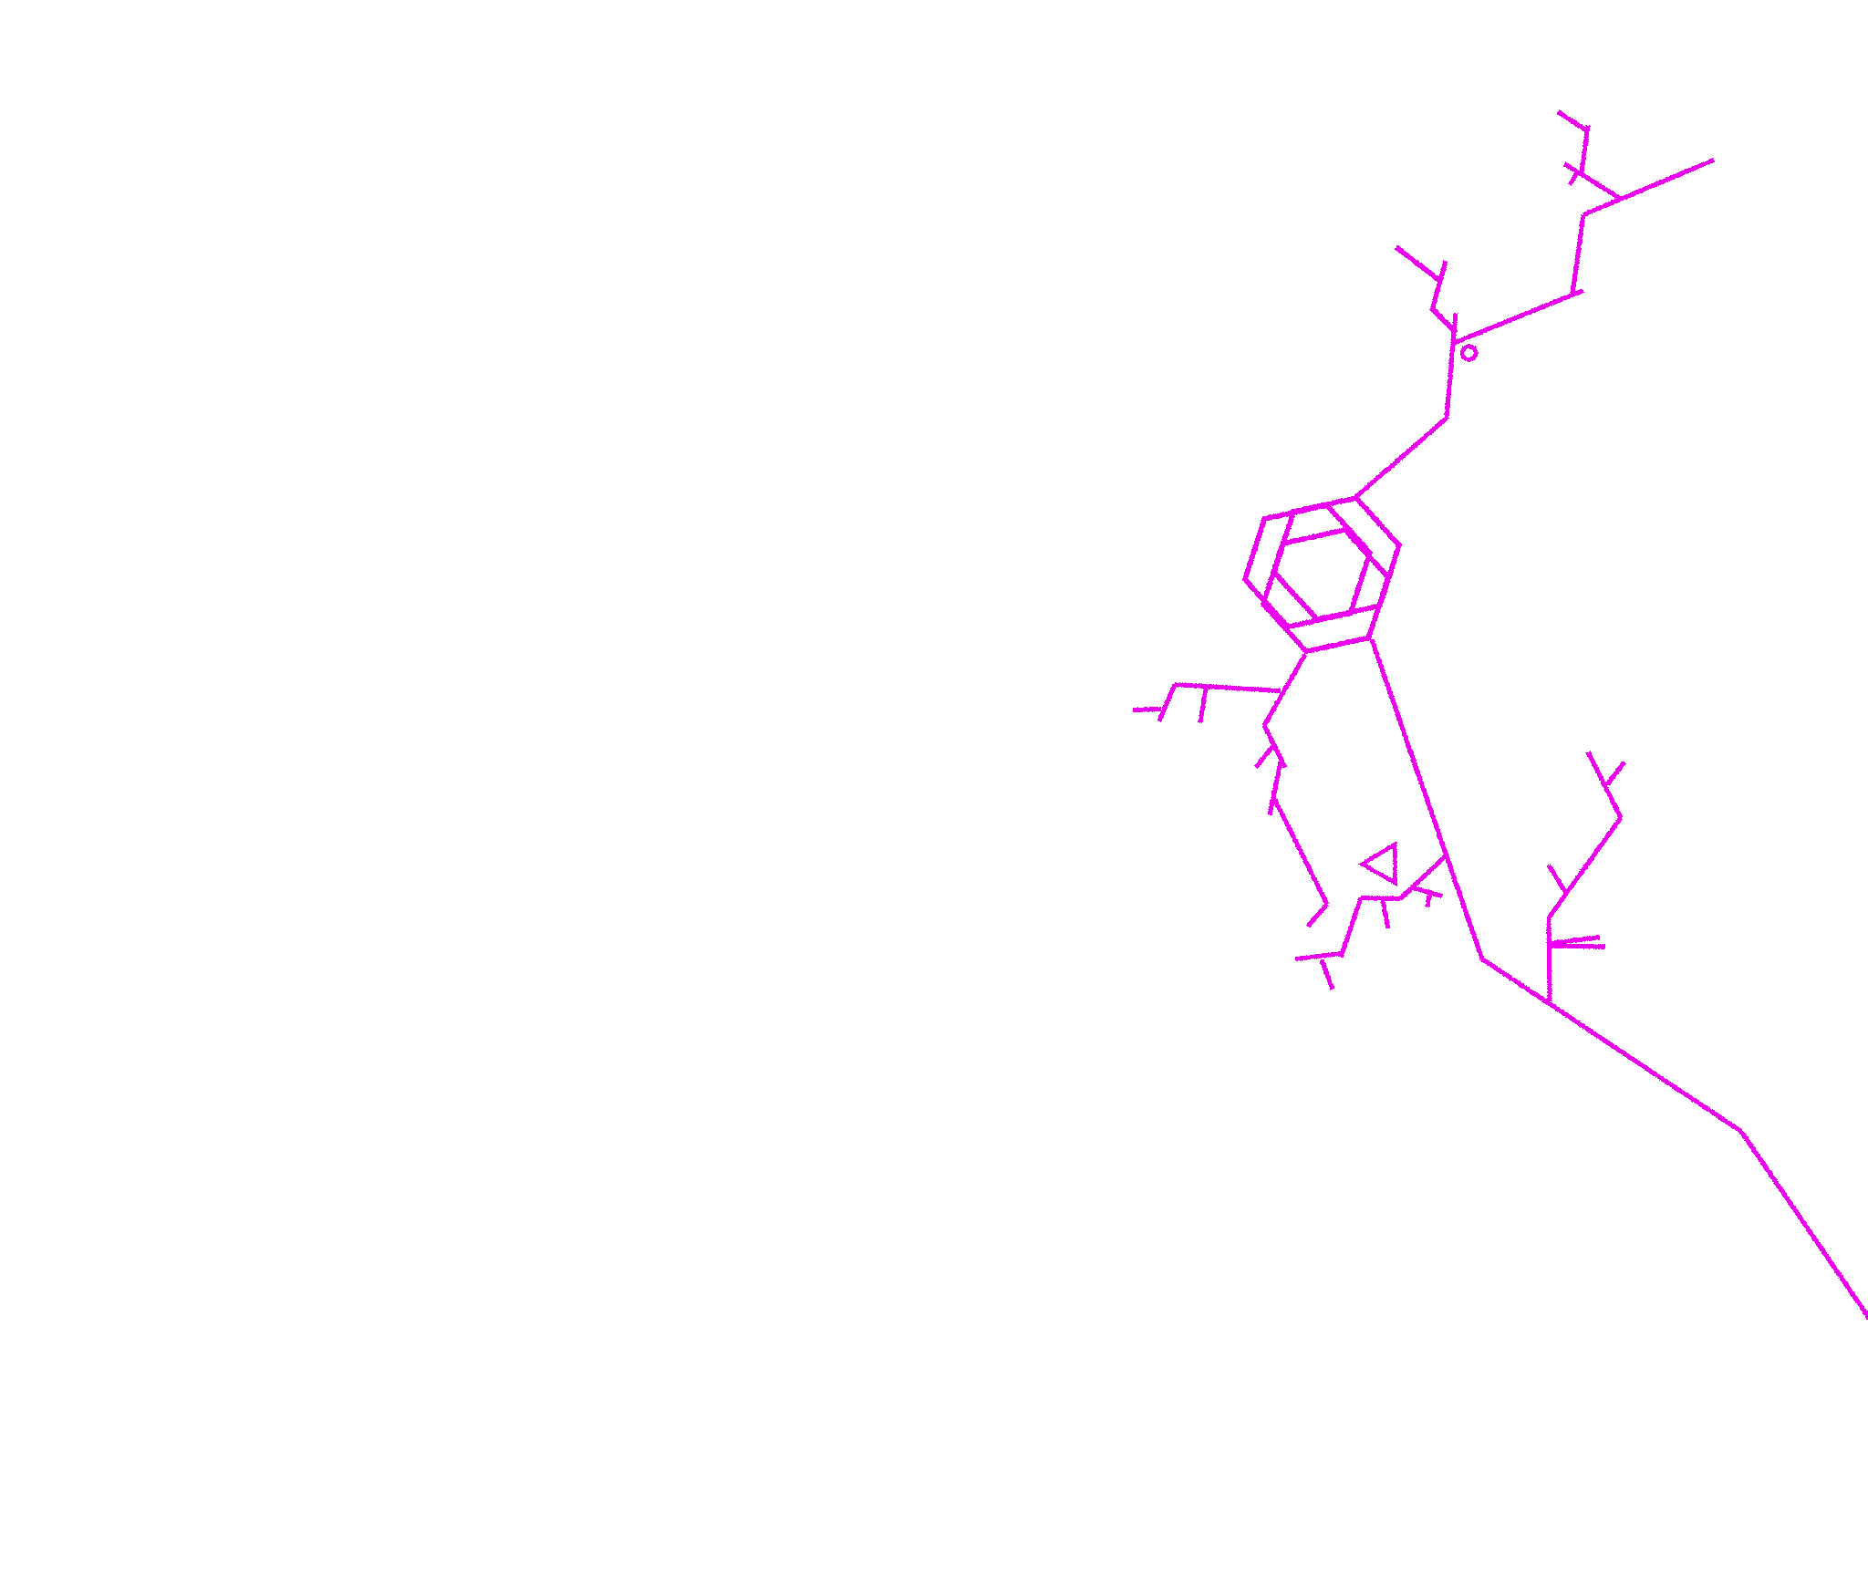
Credits & Required Texts
This playbook was made on the unceded traditional territories of the Matsqui, Kwantlen, Katzie, and Semiahmoo First Nations.
The Starbreaker Designed & Written by: Lawson Coleman Playtested by:
The Starbreaker is an in-development playbook, and the design & layout in this PDF is subject to change for any multitude of reasons.Some Abilities or gear may be imbalanced, and your mileage may vary.
There will be a more formal feedback system coming eventually after the release of the Starbreaker V0.2, but in the meantime you can either @ me on twitter or leave a comment on itch.io(please try to be respectful & patient if you do either of these things,& I will return the favor).
If you are interested in following updates on the Starbreaker(and other things I make), you can follow me on twitter @TheLawsonC!
The Game Mechanics listed in this playbook require a copy of Beam Saber by Austin Ramsay, which can be found here: Beam Saber by Austin Ramsay
Thank you to Austin for Designing & Writing such an awesome game, and for cultivating a creative & positive culture around the beam saber community. I’ve had a great time running beam saber, and designing for it has been a refreshing exercise.
Beam Saber is a Forged in the Dark Game, which is based on Blades in the Dark (found at http://www.bladesinthedark.com/ ), product of One Seven Design, developed and authored by John Harper, and licensed for our use under the Creative Commons Attribution 3.0 Unported license (http://creativecommons.org/licenses/by/3.0/).

Slide 3
Table of Contents
1: Touchstones
2: Starting Build/Play The Starbreaker if.../Pilot Gear
3: Starbreaker Starting Abilities
4: Starbreaker Ability:The Stars Call for Their Own
5: Starbreaker Ability: Fail Fast, Fail Often
6: Starbreaker Ability: In Plain Sight
7: Starbreaker Ability: Familiar
8: Starbreaker Ability: Blood Substitute
9: Starbreaker Ability: Titanbreaker
10: Starbreaker Ability: The Tower
11: Ability: Veteran
12: Arcane Ability:Sight beyond Sight
13: Arcane Ability:Blood of a Thousand Titans
14: Arcane Ability:Strength of the old gods
15: Arcane Ability:Conduit of bound solarity
16: Arcane Ability:Astral Forge of the Forsaken
17: Arcane Ability:Carried by wings of the void
18: Example Gather Information Questions/beliefs
19: Example Allies and rivals

Slide 4
Touchstones
Starbreaker end of Mission XP Trigger:
1
What does magic look like in a world dominated by war and technology? What lessons do factions learn when their enemies use arcane power to laterally push through the constant arms race of ever-increasing war machines?
Starbreakers are incredibly skilled and dangerous arcanists, whose employers struggle to contain and command their power. They each have their own personal style of Magic, and their loyalties vary greatly, but they all have one thing in common:
Their Power is stolen.
Warlocks(Destiny), the powers in the inFAMOUS games, Starkiller(The Force Unleashed),Talion/Celebrimbor(Shadow of Mordor), Lord Ephirim(Spring In Hieron), Corvo Attano(Dishonored)
Mark XP if you addressed a challenge with Arcane Knowledge or Devastation

Slide 5
Pilot Gear
Starting Build
Play The Starbreaker if...
2
A Fine Containment Suit(1 Load): A layer of under-armor that can be worn to assist in controlling collateral damage from arcane effects.
An Arcanists’ Mask(0 Load if worn, 1 if carried): A personalized mask/helmet worn to reduce sensory overload while using the Channeling Mark.
An Inoculated Signature Weapon(1 Load): A Personally customized weapon that cannot be affected by the side effects of the channeling mark.
Synthetic Relaxants(1 Load per use): Field Medication to temporarily calm an arcanist. Heals 2 stress per use, until the end of the mission, at which point you take the stress again.
Your Channeling Mark(0 Load): An arcane sigil that siphons power from something vital to life(a sun, a dying god, etc.) to produce incredible supernatural effects. It’s represented by the Channeling Mark entry on your Pilot sheet.
+1 Maneuver, +1 Battle, +1 Study, Starting Abilities
You are interested in introducing fantastical elements to your game, enjoy managing more resources(and using more abilities) than the average beam saber pilot, or if you just want to be a cool space wizard that blows up mechs.

Slide 6
Starting
Abilities
3
Bearer Of A Shattered Sun: In place of a vehicle, you have a channeling mark, an arcane sigil that siphons power from something vital to life. It has quirks and scale as normal. Instead of vehicle gear, you mark off and gain access to different arcane abilities, which each have their own load cost. When you expend stress, you may remove an arcane ability.
The Cost Of Power: When you take a scar, choose an arcane ability. You gain that ability at Load 0, but it is now permanent and cannot be removed.

Slide 7
Starbreaker Abilities
4
The Stars Call for Their Own: Take this ability when you take your third scar. The Source of your power has placed its focus on you. It is your rival. You cannot retire upon taking a fourth scar; When you take a scar, your maximum stress is reduced by 3. When your maximum stress is 0, you are doomed to be taken by the stars, and will not make it through the next mission. What that end looks like is up to you.

Slide 8
Starbreaker Abilities
5
Fail Fast, Fail Often:When You Complete a long-term project to Develop a new arcane ability, You may clear all non-permanent arcane abilities you have active and change the scale of your channeling mark.

Slide 9
Starbreaker Abilities
6
In Plain Sight:You can suppress the visual effects of your arcane abilities. When those visual effects draw attention, mark XP.

Slide 10
Starbreaker Abilities
7
Familiar: Gain a specialist cohort. Its’ Expertise is "Magic". When this cohort assists you in using any supernatural ability, gain both improved position and effect. This Cohort cannot help another Pilot in this way without a long term project to familiarize the cohort with the pilot.

Slide 11
Starbreaker Abilities
8
Blood Substitute:You may take the level one harm "Drained" to push yourself for +2d. You may increase the harm's level up to 3 for an additional +1d per level. This Harm can be resisted as normal.

Slide 12
Starbreaker Abilities
9
Titanbreaker: Take improved effect on fighting vehicles of any size.When you defeat a vehicle with an arcane ability, heal a harm by one level.

Slide 13
Starbreaker Abilities
10
The Tower:You have an Arcanist’s Den, your own personal FOB. It has the Playbook training upgrade, and a second upgrade of your own choice. Only you can take advantage of the Den’s Upgrades.

Slide 14
Starbreaker Abilities
11
Veteran: Choose a special ability from another source. Can be taken up to three times.

Slide 15
Arcane
Abilities
12
Sight Beyond Sight (1 Load): You can see through walls and solid barriers, and are capable of seeing distant objects in greater detail. Your eyes glow with an otherworldly light, blinding those who look into them.

Slide 16
Arcane
Abilities
13
Blood of a Thousand Titans (3 Load): When you take harm, you can choose to instead take an equivalent level of damage to your Channeling Mark. Your Body is covered with incandescent arcane tattoos that flare even brighter and sting when your Channeling Mark is damaged.

Slide 17
Arcane
Abilities
14
Strength of the Old Gods (5 Load): By taking harm of a level equal to the tier of the target’s squad, minus the tier of your squad(min 1), You can telekinetically lift and throw objects smaller than a large vehicle. Your body is wholly enveloped in an arcane fire that dissolves metal.

Slide 18
Arcane
Abilities
15
Conduit of Bound Solarity (3 Load):When you take harm from energy weapons, you can choose to direct the energy into your channeling mark. When you do so, spend 1 stress and gain 1 additional load for your channeling mark until the end of the mission. Your Channelling Mark appears as a scale level higher than normal.

Slide 19
Arcane
Abilities
16
Astral Forge of the Forsaken(1 load per use): You produce a fine pilot weapon, or the effects of a fine vehicle weapon of any kind. This move cannot be made permanent by The Cost Of Power. Your hands crackle with arcane energy, short-circuiting mundane electronics.

Slide 20
Arcane
Abilities
17
Carried by Wings of the Void (2 Load): You can fly, and can survive without oxygen. Massive wings sprout from your shoulders.

Slide 21
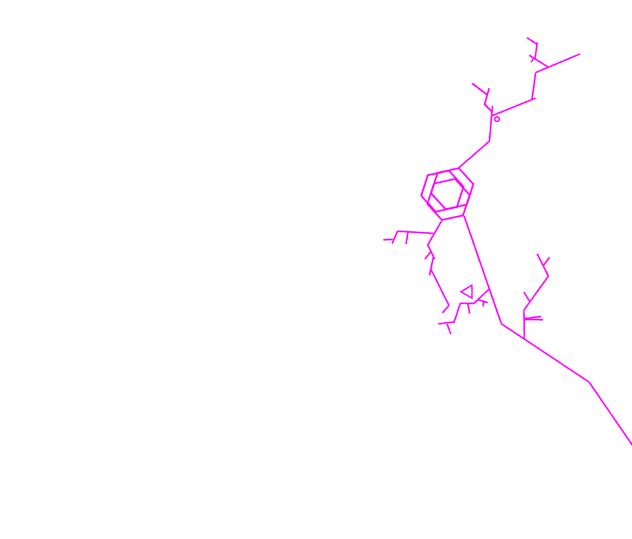
Example Gather Information Questions
Example Starting Beliefs
18
What’s really going on here?
What here can match my power?
What can I leverage that others can’t?
Who here knows what I can do?
Are there any other Starbreakers Nearby?
What is the source of their power?
They seek to restrict me. I will work past them.
I will use my skills to help their cause if the opportunity presents itself.
Their methods are outdated and unnecessary. I will show them the new ways.
Their concerns with the arcane are unfounded.

Slide 22
Example Starbreaker Allies And Rivals
19
d6 | Example Allies
1 | _____, a retired arcanist
2 | _____, an eager apprentice
3 | _____, a concerned researcher
4 | _____, a former colleague and Mech Pilot
5 | _____, a forward-looking engineer
6 | Roll twice. First result is their background, second is their current life.
d6 | Example Rivals
1 | _____, a notorious Mage Hunter
2 | _____, a victim of collateral damage from an arcanist
3 | _____, a Zealous Commander
4 | _____, a strange and beautiful star-born creature
5 | _____, a persistent journalist
6 | Roll twice. First result is their background, second is their current life.

